Slide 1
Foundations of Machine Learning
Module 2: Linear Regression and Decision Tree
Part D: Overfitting
Sudeshna Sarkar
IIT Kharagpur

Slide 2
Overfitting
Learning a tree that classifies the training data perfectly may not lead to the tree with the best generalization performance.
There may be noise in the training data
May be based on insufficient data
A hypothesis h is said to overfit the training data if there is another hypothesis, h’, such that h has smaller error than h’ on the training data but h has larger error on the test data than h’.

Slide 3
Overfitting
Learning a tree that classifies the training data perfectly may not lead to the tree with the best generalization performance.
There may be noise in the training data
May be based on insufficient data
A hypothesis h is said to overfit the training data if there is another hypothesis, h’, such that h has smaller error than h’ on the training data but h has larger error on the test data than h’.
On training
accuracy
On testing
Complexity of tree

Slide 4
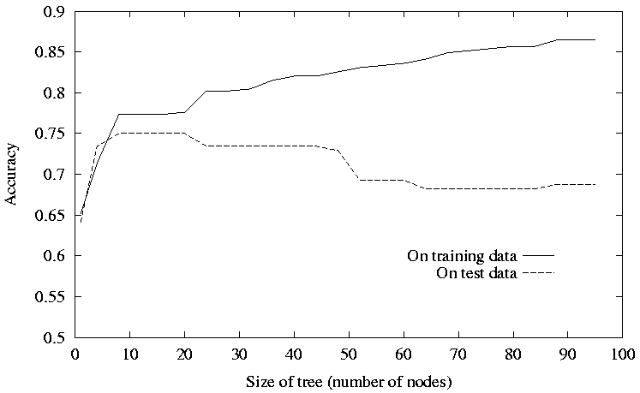
Overfitting
©Tom Mitchell, McGraw Hill, 1997

Slide 5
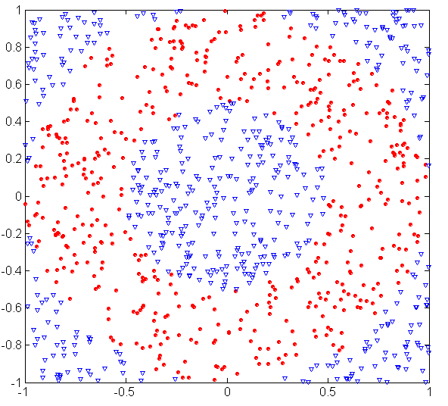
Underfitting and Overfitting (Example)
500 circular and 500 triangular data points.
Circular points:
0.5 ≤ sqrt(x₁²+x₂²) ≤ 1
Triangular points:
sqrt(x₁²+x₂²) > 0.5 or
sqrt(x₁²+x₂²) < 1

Slide 6
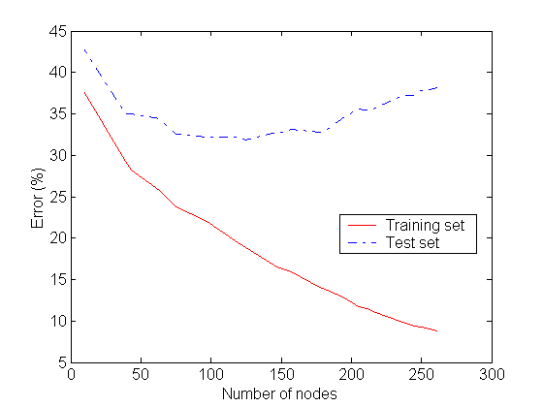
Underfitting and Overfitting
Overfitting
Underfitting: when model is too simple, both training and test errors are large

Slide 7
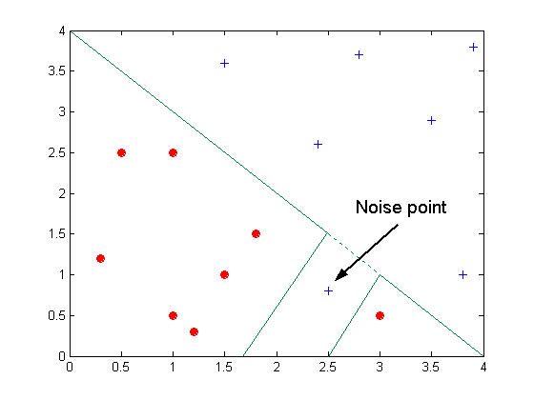
Overfitting due to Noise
Decision boundary is distorted by noise point

Slide 8
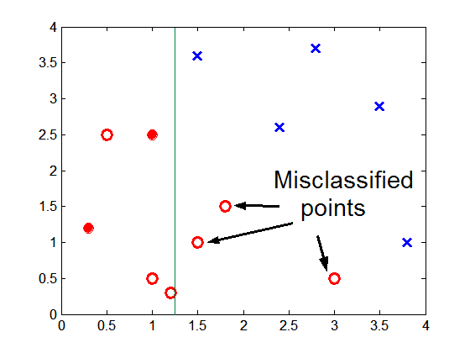
Overfitting due to Insufficient Examples
Lack of data points makes it difficult to predict correctly the class labels of that region

Slide 9
Notes on Overfitting
Overfitting results in decision trees that are more complex than necessary
Training error no longer provides a good estimate of how well the tree will perform on previously unseen records

Slide 10
Avoid Overfitting
How can we avoid overfitting a decision tree?
Prepruning: Stop growing when data split not statistically significant
Postpruning: Grow full tree then remove nodes
Methods for evaluating subtrees to prune:
Minimum description length (MDL):
Minimize: size(tree) + size(misclassifications(tree))
Cross-validation

Slide 11
Pre-Pruning (Early Stopping)
Evaluate splits before installing them:
Don’t install splits that don’t look worthwhile
when no worthwhile splits to install, done

Slide 12
Pre-Pruning (Early Stopping)
Typical stopping conditions for a node:
Stop if all instances belong to the same class
Stop if all the attribute values are the same
More restrictive conditions:
Stop if number of instances is less than some user-specified threshold
Stop if class distribution of instances are independent of the available features (e.g., using χ ² test)
Stop if expanding the current node does not improve impurity measures (e.g., Gini or information gain).

Slide 13
Reduced-error Pruning
A post-pruning, cross validation approach
- Partition training data into “grow” set and “validation” set.
- Build a complete tree for the “grow” data
- Until accuracy on validation set decreases, do:
For each non-leaf node in the tree
Temporarily prune the tree below; replace it by majority vote
Test the accuracy of the hypothesis on the validation set
Permanently prune the node with the greatest increase
in accuracy on the validation test.
Problem: Uses less data to construct the tree
Sometimes done at the rules level
General Strategy: Overfit and Simplify

Slide 14
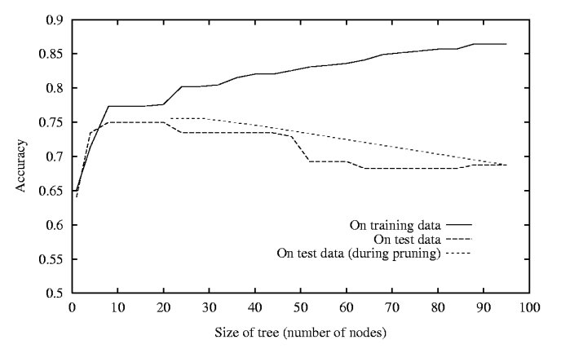
Reduced Error Pruning

Slide 15
Model Selection & Generalization
Learning is an ill-posed problem; data is not sufficient to find a unique solution
The need for inductive bias, assumptions about H
Generalization: How well a model performs on new data
Overfitting: H more complex than C or f
Underfitting: H less complex than C or f

Slide 16
Triple Trade-Off
There is a trade-off between three factors:
Complexity of H, c (H),
Training set size, N,
Generalization error, E on new data
As N increases­, E decreases
As c (H) increases­, first E decreases and then E­ increases
As c (H)­ increases, the training error decreases for some time and then stays constant (frequently at 0)
overfitting

Slide 17
Notes on Overfitting
overfitting happens when a model is capturing idiosyncrasies of the data rather than generalities.
Often caused by too many parameters relative to the amount of training data.
E.g. an order-N polynomial can intersect any N+1 data points

Slide 18
Dealing with Overfitting
Use more data
Use a tuning set
Regularization
Be a Bayesian

Slide 19
Regularization
In a linear regression model overfitting is characterized by large weights.

Slide 20
Penalize large weights in Linear Regression
Introduce a penalty term in the loss function.
Regularized Regression
(L2-Regularization or Ridge Regression)
L1-Regularization

